Slide 1
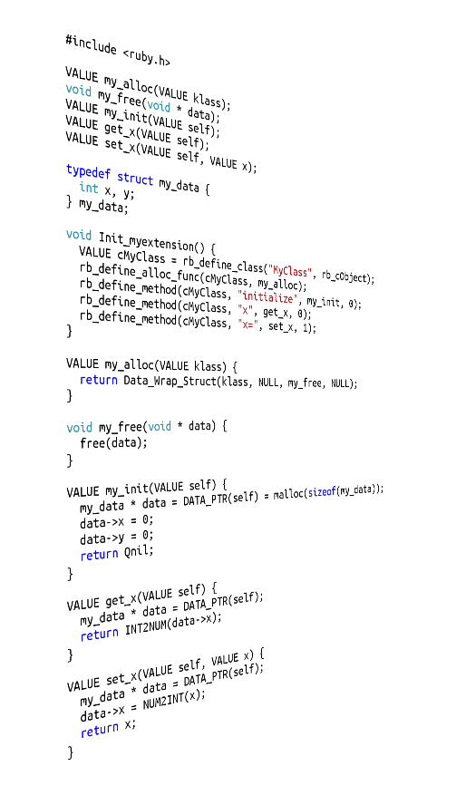


Extending
Ruby with C
David Grayson
Las Vegas Ruby Meetup, 2013-10-23
Previously presented 2011-11-16

Slide 2
Why make a C extension?
To access C libraries from Ruby
To run CPU-intensive algorithms
Along the way you learn
more about Ruby!

Slide 3
What can a C extension do?
Almost everything that Ruby can!
  Convert between Ruby and C data
  Call Ruby methods
  Define classes, modules, methods, constants
  Throw or rescue exceptions
  Access Ruby variables
  Define blocks and yield values to blocks
  Be packaged in a gem

Slide 4
What else can a C extension do?
Lots of things that Ruby can't!
  Looks like the source of MRI
  Store a hidden pointer in a Ruby object
  Add hooks to Ruby interpreter
  Define read-only global variables
  Global variables with get and set hooks

Slide 5
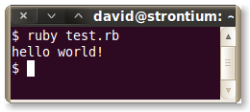
Your first C extension
myextension.c:
test.rb:
#include <ruby.h>
void Init_myextension()
{
printf("hello world!\n");
}
require_relative 'myextension'
extconf.rb:
require 'mkmf'
$CFLAGS += ' -std=gnu99'
create_makefile 'myextension'
Run these commands:
ruby extconf.rb
make

Slide 6
Defining a Ruby class
class MyClass
def foo(arg1)
end
end
What we want to do:
Equiavalent code in C:
#include <ruby.h>
VALUE foo(VALUE self, VALUE arg1)
{
return Qnil;
}
void Init_myextension()
{
VALUE cMyClass = rb_define_class("MyClass", rb_cObject);
rb_define_method(cMyClass, "foo", foo, 1);
}

Slide 7
The VALUE type
Represents any Ruby object
Is defined in ruby.h to be an unsigned integer the same size as a pointer (void *).
typedef unsigned long VALUE;
32-bit VALUE space
MSB ------------------------ LSB
object oooooooooooooooooooooooooooooo00 : pointer to C struct
fixnum fffffffffffffffffffffffffffffff1 : 31-bit signed int
symbol ssssssssssssssssssssssss00001110 : ruby symbol
false 00000000000000000000000000000000
true 00000000000000000000000000000010
nil 00000000000000000000000000000100
undef 00000000000000000000000000000110
Source: gc.c in Ruby source code

Slide 8
Getting the TYPE of a VALUE
The TYPE(obj) macro gets the type of a VALUE:
T_NIL nil
T_OBJECT ordinary object
T_CLASS class
T_MODULE module
T_FLOAT floating point number
T_STRING string
T_REGEXP regular expression
T_ARRAY array
T_HASH associative array
T_STRUCT (Ruby) structure
T_BIGNUM multi precision int
T_FIXNUM Fixnum(31/63bit int)
T_COMPLEX complex number
T_RATIONAL rational number
T_FILE IO
T_TRUE true
T_FALSE false
T_DATA data
T_SYMBOL symbol
The TYPE is not the same thing as the class!

Slide 9
Reading basic types
VALUE foo(VALUE self, VALUE obj)
{
switch (TYPE(obj)) {
case T_FIXNUM:;
int val = NUM2INT(obj);
printf("Fixnum: %d\n", val);
break;
case T_STRING:;
char * string = StringValuePtr(obj);
printf("String: %s\n", string);
break;
case T_ARRAY:;
unsigned long length = RARRAY_LEN(obj);
printf("Array: %ld\n", length);
break;
}
return Qnil;
}
MyClass.new.foo 12 #=> Fixnum: 12
MyClass.new.foo "hi" #=> String: hi
MyClass.new.foo [0,3] #=> Array: 2

Slide 10
Creating basic types
VALUE foo2(VALUE self)
{
VALUE string = rb_str_new2("hello");
VALUE number = INT2NUM(44);
VALUE array = rb_ary_new3(2, string, number);
return array;
}
MyClass.new.foo2 #=> ["hello", 44]

Slide 11
Calling Ruby methods
def foo(obj)
obj + obj
end
What we want to do:
Equiavalent code in C:
VALUE foo(VALUE self, VALUE obj)
{
VALUE doubled = rb_funcall(obj, rb_intern("+"), 1, obj);
return doubled;
}
MyClass.new.foo "boo" #=> "booboo"
MyClass.new.foo 44 #=> 88

Slide 12
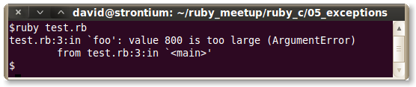
Raising Exceptions
VALUE foo(VALUE self, VALUE num)
{
int x = NUM2INT(num);
if (x > 100)
{
rb_raise(rb_eArgError, "value %d is too large", x);
printf("this does not ever run\n");
}
return Qnil;
}
test.rb:
require_relative 'myextension'
MyClass.new.foo 800

Slide 13
Ruby objects, C objects, coexist!
Ruby objects
C data structures

Slide 14
Data_Wrap_Struct
typedef void (*RUBY_DATA_FUNC)(void*);
VALUE Data_Wrap_Struct(
VALUE class,
RUBY_DATA_FUNC mark,
RUBY_DATA_FUNC free,
void * ptr
);
You want to call this when
a new object is created...

Slide 15
How objects are made
Object.new:
  Calls class's allocator method to allocate memory.
  Calls object's #initialize method.

Slide 16
Data Pointer Strategy
A strategy for C extensions:
  In allocator, use Data_Wrap_Struct, with NULL pointer.
  In #initialize, set the value of the pointer.
  Free the pointer when the ruby object is garbage collected.
  If needed, provide a #close method to free the pointer early.

Slide 17
Data Pointer Example
#include <ruby.h>
VALUE my_alloc(VALUE klass);
void my_free(void * data);
VALUE my_init(VALUE self);
VALUE get_x(VALUE self);
VALUE set_x(VALUE self, VALUE x);
typedef struct my_data {
int x, y;
} my_data;
void Init_myextension() {
VALUE cMyClass = rb_define_class("MyClass", rb_cObject);
rb_define_alloc_func(cMyClass, my_alloc);
rb_define_method(cMyClass, "initialize", my_init, 0);
rb_define_method(cMyClass, "x", get_x, 0);
rb_define_method(cMyClass, "x=", set_x, 1);
}
VALUE my_alloc(VALUE klass) {
return Data_Wrap_Struct(klass, NULL, my_free, NULL);
}
VALUE my_init(VALUE self) {
my_data * data = DATA_PTR(self) = malloc(sizeof(my_data));
data->x = 0;
data->y = 0;
return Qnil;
}
void my_free(void * data) {
free(data);
}
VALUE get_x(VALUE self) {
my_data * data = DATA_PTR(self);
return INT2NUM(data->x);
}
VALUE set_x(VALUE self, VALUE x) {
my_data * data = DATA_PTR(self);
data->x = NUM2INT(x);
return x;
}

Slide 18
Supporting Ruby implementations
Matz Ruby Interpreter: yes
Rubinius: yes
JRuby: it used to support C extensions

Slide 19
Alternatives
CLI written in C
dl, fiddle, ffi
require 'ffi'
module MyLib
extend FFI::Library
ffi_lib 'c'
attach_function :puts, [ :string ], :int
end
MyLib.puts 'Hello, World using libc!'

Slide 20
Resources
Excellent PDF by Dave Thomas:
  http://media.pragprog.com/titles/ruby3/ext_ruby.pdf
Official document in Ruby source code:
  https://github.com/ruby/ruby/blob/trunk/README.EXT
EscapeUtils, a simple gem with a C extension:
  https://github.com/brianmario/escape_utils

Slide 21
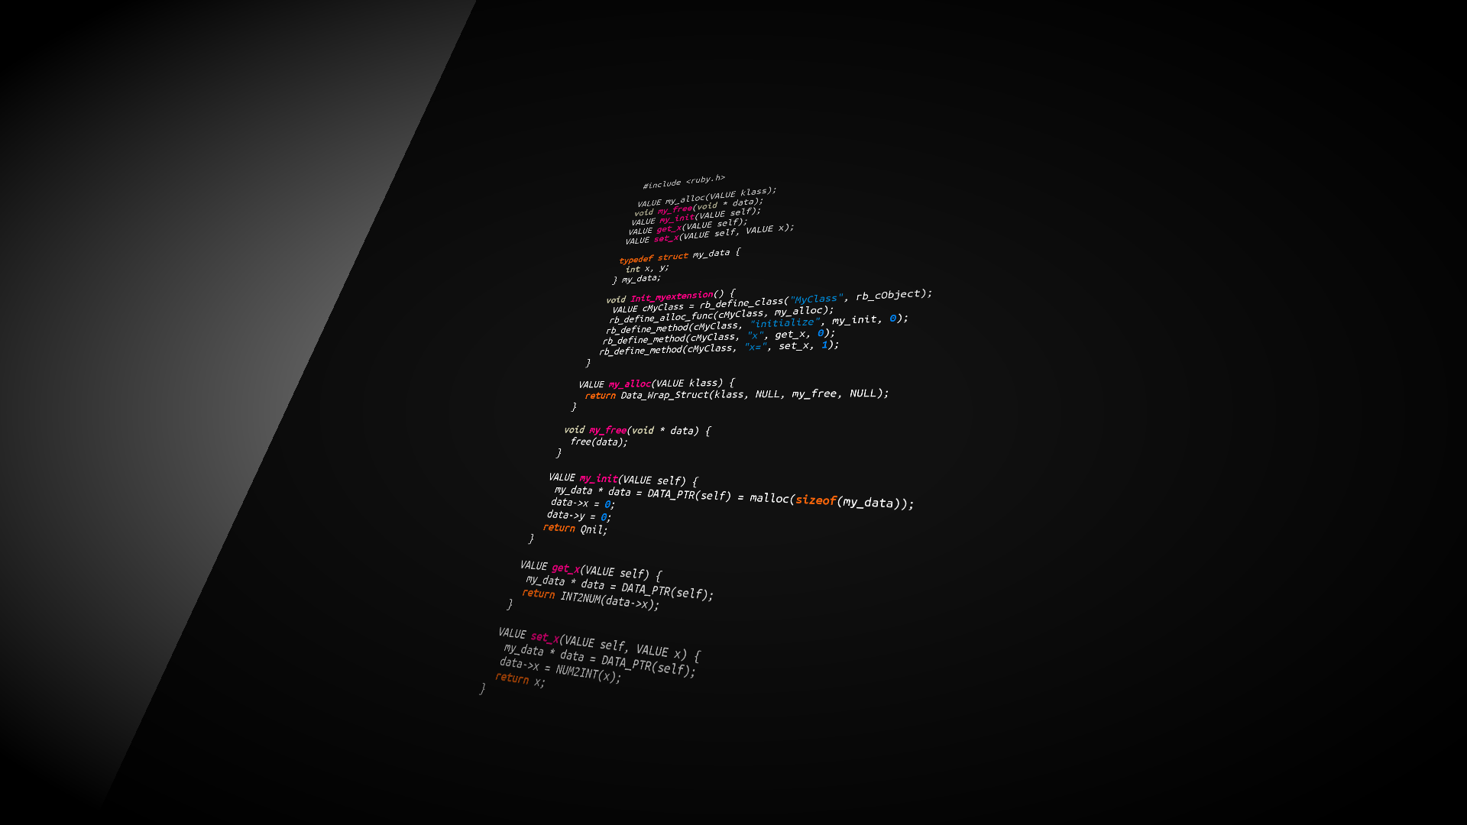
http://instacod.es

